Slide 1
Hydro-Electric Power
By – Tejaswini Moparthi
Sohail Ginwala

Slide 2
Definition: Hydro-electric power refers to generation of electricity through the motion of free-falling water.

Slide 4
Hydroelectricity is considered as a renewable energy source.
Out of all he renewable energy sources for example – solar power, wind power, biomass etc, Hydro power holds the largest share of worldwide electricity production.
The modern Hydro plants produce electricity by using turbines and generators.
The working mechanism of hydro plant is that the mechanical energy generated by the moving waters helps the turbine to spin.
This turbine which in turn is connected to the electro magnetic generator results in production of electricity as the turbine spins.

Slide 5
How It Works…….

Slide 6
Two types of Hydro-Electric Power Plants:
Dams
1] High Head (800 or more feet)
2] Medium Head (100 to 800 feet)
3] Low Head (less than 100 feet)
Run of river

Slide 7
Types of installation

Slide 8
Introduction:

Slide 9
Details:
In order to generate to generate the hydroelectric power, the collected or stored water is at a higher elevation and eventually directed downwards through large tunnels or pipes also known as penstocks to a lower elevation
At the end of the pipes, the falling water causes turbines to rotate. The turbines in turn drive generators.
The turbines convert mechanical energy into electricity.
Transformers come in the picture which are then used to convert the alternating voltage suitable for the generators to a higher voltage which suitable for long-distance transmission.
Power house is the structure that is equipped with the turbines and generators, and eventually into which the pipes or penstocks feed.

Slide 10
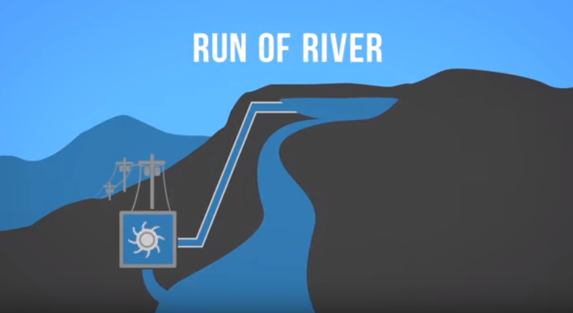
Run of river:
In Run of river system, running water is diverted from a flowing river and guided down a channel, or penstock, which leads to a generating house. The force of moving water spins a turbine and drives a generator.
The difference between run-of-river and hydropower dam is that run-of-river do not have a reservoir to store water, where as the dams have a reservoir to store large amounts of water.
British Columbia is mostly using run-of-river facilities.

Slide 11
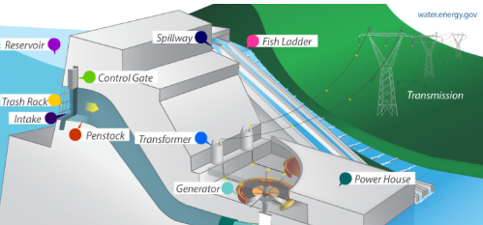
Major Components Of Hydro Powerplant:
Reservoir
Dam & Spillways
Intake or control gates
Penstock
Turbines
Generators

Slide 12
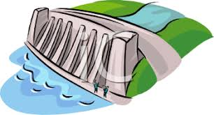
Dam
Dam is the most important component of the power plant
The dam is constructed on a large river that has water in abundance all over the year.
In order to get the maximum potential energy of water, the height of the river should meet the sufficient requirements.

Slide 13
Dams:
A Dam is a large barrier which is constructed in order to raise the level of water and eventually control the flow of water.
When the water is released from the dam, it creates an elevation which turns the turbine due to the gravitation force.
The electricity is produced by utilizing the potential energy from the dam water.
In the situation to produce more electricity, some dams have additional reservoir at their base so that water is stored and then pumped to the higher reservoir. This is referred to as ‘Pumped storage hydro’.

Slide 14
Reservoir:
The water reservoir is the water storage spot of a dam .
It is located higher to the other dam structure.
The height of the reservoir decides the potential energy of the water. Higher the height, more the potential energy.
The high position also reflects the effortless downward fall of water.

Slide 15
Intake or control gates:
Control gates reside in the inner area of the dam.
The water which is let out by the reservoir is controlled through these gates.
These gates are also called inlet gates because the water enters power generation units through these gates.
The water is forced to flow through the penstock due to gravitational force and then to the turbines , once these gates are opened.

Slide 16
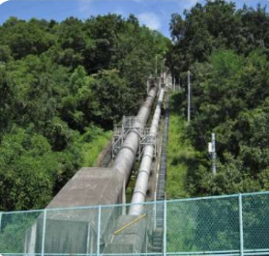
Penstock:
The penstock is the long pipe that feeds water to the turbines from reservoir.
The water in penstock possess kinetic energy because of its motion and potential energy because of its height.
The power generation in hydroelectric power plant depends majorly on two factors, first is the height of reservoir and amount of water flowing though the penstock.

Slide 17
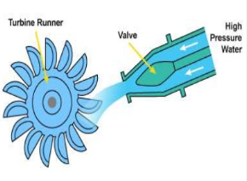
Turbines:
The flowing water from penstock enters the power generation unit which contains Turbine and Generator.
A turbine is a rotary machine which converts kinetic energy of water into mechanical energy.
There are different types of turbines and the choice of turbines depend on the water head and on flow rate of water.
Small turbines have horizontal shafts and large turbines like Francis and Kaplan are equipped with vertical shafts.
The flowing water spins the turbine and eventually rotates the shaft.

Slide 18
Types of Turbines
Reaction Turbines
Derive power from pressure drop across turbine.
Totally immersed in water.
Angular and linear motion gets converted into shaft power.
i.e : propeller , Kaplan, and francis turbine.
Impulse Turbines
No pressure drop across the turbines.
The blades are usually bucket-shaped so they catch the fluid and direct it off at an angle or sometimes even back the way it came.
i.e: pelton, Turgo, and crossflow turbines.

Slide 19
Francis Turbine cross section

Slide 20
Proppeller Turbine

Slide 21
Vertical Kaplan Turbine setup

Slide 22
Horizontal Kaplan Turbine setup

Slide 23
Selection of Turbine

Slide 24
Fish Friendly Turbine Design

Slide 25
Generators:
The generator converts the mechanical energy into electrical energy.
The shaft that rotates because of the turbine results in the alternating current in the coils of generator.
The rotating shaft inside the generator produces magnetic field which is converted into electricity by electromagnetic induction.

Slide 26
Equations
Power is proportional to the product of head x flow.
Hydropower is very efficient.
Efficiency = Electric power delivered to the busbar/potential energy of head water.
Typical losses are due to :
Frictional drag and turbulence of flow
Friction and magnetic losses in turbine and generator.
Overall efficiency ranges from 75-95%.

Slide 27
More Equations…..

Slide 28
Sources of Electric Power in USA

Slide 29
Domination of Hydro amongst renewable sources

Slide 30
Major Hydropower Producers across the Globe

Slide 31
Uses of Dams in USA

Slide 32
World Energy Sources

Slide 33
Robert Moses Hydro Power Plant

Slide 34
Robert Moses Niagara Hydroelectric Power Plant:
It is a hydro electric power station located in Lewiston, New York near Niagara Falls.
It is operated by New york Power Authority(NYPA). This plant diverts water from the Niagara river above Niagara Falls and returns the water into the lower portion of the river near Lake Ontario.
It has 13 turbines and generators at an installed capacity of 2,675 megawatts.
It has a pump generating plant was constructed not only to control the flow of water but to contain man-made 1900-acre, 22 billion gallon upper reservoir called Lewiston reservoir which stores the water before being released into the forebay.

Slide 35
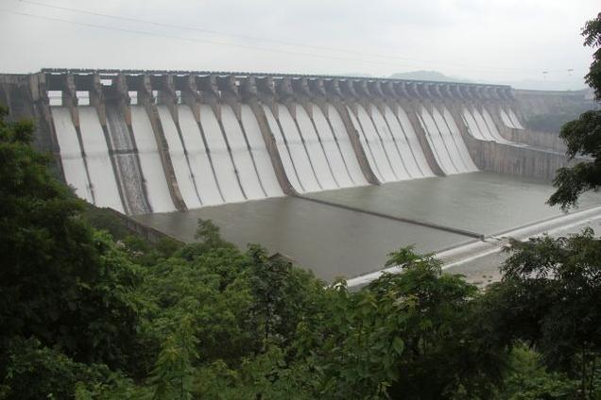
Sardar Sarovar Dam :

Slide 36
Salient Features

Slide 38
Awareness !
Awareness is first step towards change.
Awareness builds the path for acceptance.
Different ways of awareness can be categorized as;
Education
Media

Slide 39
Power of cinema

Slide 41
Inspiration follows…..

Slide 42
Quick overview……

Slide 43
Concerns:
Major concern in this energy source can be by dams. Building the dams on river can affect the local environment, for example changing wildlife habitats, blocking the fish passage and also forcing the people to reside away from the dams.
In case of failure of dams, it can be catastrophic as for people living downstream.
In addition to this, Hydro plants are also not free of greenhouse gas emissions. For example, carbon di oxide is emitted during the construction majorly because of the use of large quantities of cement.

Slide 44
Thank You!

