Slide 1
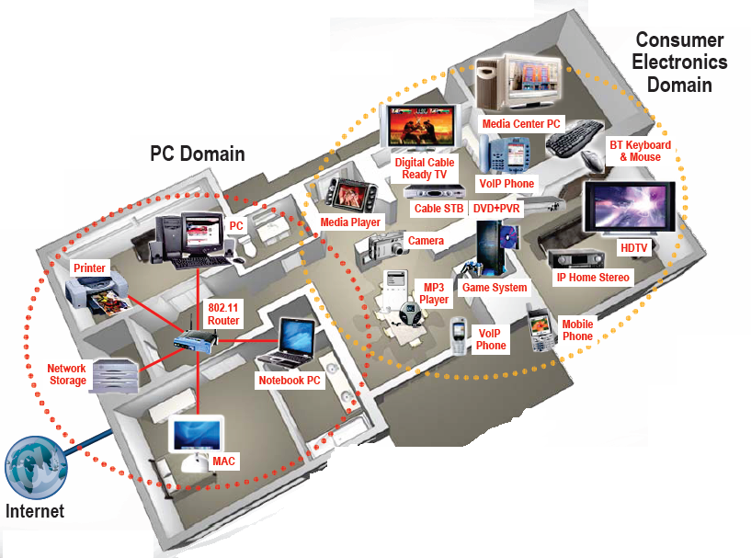

EE 383: Wireless Communications
Professor Jeffrey N. Denenberg

Slide 2
Outline
Course Basics
Course Syllabus
The Wireless Vision
Technical Challenges
Current Wireless Systems
Emerging Wireless Systems
Spectrum Regulation
Standards

Slide 3
Course Information
Nuts and Bolts
Prerequisites:
  EE321 or equivalent (Electromagnetic Fields)
  EE231 or equivalent (Circuits 1)
Required textbook: Wireless Communications, CUP
Class homepage: EE383/ECE450
  All handouts, announcements, homework, etc. posted to website
  And on Mentor
Notes:
Other relevant subjects/courses:
- Probability and Noise (EE391 at Fairfield, AKA “Stochastic Processes)
- Digital Communications (EE352 at Fairifeld)

Slide 4
Course Information
Policies
Grading: HW- 25%, Exams (2) - 25% each, Project - 25%
HW: assigned Monday, due following Monday at 5pm
  Homework lose credit for late submission to Mentor
  Collaboration means collaborators work out how to do problems together, but actually solve and submit them independently to Mentor
Exams:
  Exams are to be taken at scheduled time, makeup exams are difficult to schedule.
Notes:
Doing the HW and discussing the solutions in class leads to better understanding and better results on exams.

Slide 5
Course Information
Projects
The term project is a research project related to any topic in wireless
Two people may collaborate if you convince me the sum of the parts is greater than each individually
A 1 page proposal is due 10/21 at 5 pm.
  5-10 hours of work typical for proposal
  Proposal posted on Mentor in the appropriate slot
The project is due by 5 pm on 12/9 (on Mentor - full report and PowerPoint) along with a class presentation.
Notes:
Get started on the project early so that the project grade will help your overall grade vs hurting your overall grade

Slide 6
Course Syllabus
Overview of Wireless Communications
Path Loss, Shadowing, and Fading Models
Capacity of Wireless Channels
Digital Modulation and its Performance
Adaptive Modulation
Diversity
MIMO Systems
Multicarrier Modulation
Spread Spectrum
Multiuser Communications & Wireless Networks
Notes:
The later topics will be covered as time allows

Slide 7
Wireless History
Ancient Systems: Smoke Signals, Carrier Pigeons, …
Radio invented in the 1880s by Marconi
Many sophisticated military radio systems were developed during and after WW2
Cellular has enjoyed exponential growth since 1988, with almost 5 billion users worldwide today
  Ignited the wireless revolution
  Voice, data, and multimedia ubiquitous
  Use in third world countries growing rapidly
Wifi also enjoying tremendous success and growth
Wide area networks (e.g. Wimax) and short-range Systems other than Bluetooth (e.g. UWB) less successful
Notes:
Russians credit Alexander Stepanovich Popov with the invention of radio (both built receivers in 1894) and some credit Nickolas Tesla
Cellular (analog) was already commercialized in 1976 when I met a Taxi driver who used a “lunch pail” telephone as his only personal telephone.

Slide 8
Future Wireless Networks
Ubiquitous Communication Among People and Devices
Next-generation Cellular
Wireless Internet Access
Wireless Multimedia
Sensor Networks
Smart Homes/Spaces
Automated Highways
In-Body Networks
All this and more …
Notes:
Not to mention:
- WiDi: Intels wireless display system
- Wireless HDMI
- etc.

Slide 9
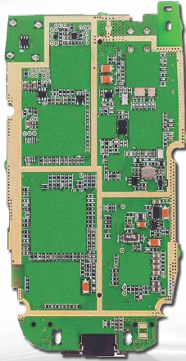
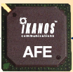
Challenges
Network Challenges
  Scarce spectrum
  Demanding/diverse applications
  Reliability
  Ubiquitous coverage
  Seamless indoor/outdoor operation
Device Challenges
  Size, Power, Cost
  Multiple Antennas in Silicon
  Multiradio Integration
  Coexistance
BT
FM/XM
GPS
Cellular
DVB-H
Apps
Processor
WLAN
Media
Processor
Wimax
Notes:
Public concerns about RF health

Slide 10
Software-Defined (SD) Radio:
Is this the solution to the device challenges?
BT
FM/XM
A/D
Cellular
GPS
A/D
DVB-H
DSP
Apps
Processor
A/D
WLAN
Media
Processor
Wimax
A/D
Wideband antennas and A/Ds span BW of desired signals
DSP programmed to process desired signal: no specialized HW
Today, this is not cost, size, or power efficient
Compressed sensing may be a solution for sparse signals
Notes:
But rapidly gaining on other approaches due to progress in digital IC technology. Remember, our text was published in 2005.

Slide 11
Current Wireless Systems
Cellular Systems
Wireless LANs
Convergence of Cellular and WiFi
WiGig and Wireless HD
Satellite Systems
Zigbee radios

Slide 12
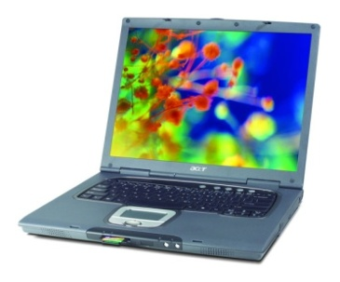
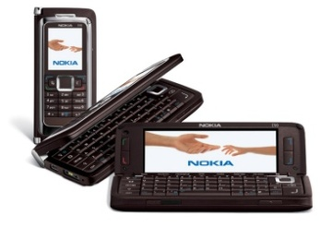
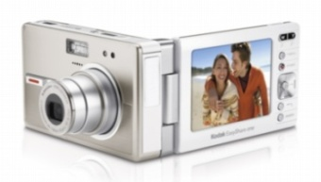

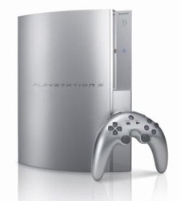
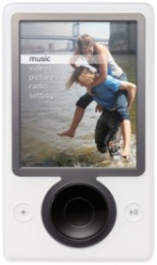
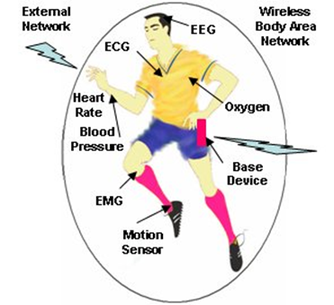
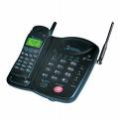
Cellular Phones
Burden for this performance is on the backbone network
Everything wireless in one device
San Francisco
BS
BS
LTE backbone is the Internet
Internet
Paris
N^{th}-Gen
Cellular
Phone
System
N^{th}-Gen
Cellular
BS
Much better performance and reliability than today
- Gbps rates, low latency, 99% coverage indoors and out
Notes:
Also the older 4G WiMax systems

Slide 13
Cellular Systems:
Reuse channels to maximize capacity
Geographic region divided into cells
Frequency/timeslots/codes reused at spatially-separated locations.
Co-channel interference between same color cells (reuse 1 common now).
Base stations/MTSOs coordinate handoff and control functions
Shrinking cell size increases capacity, as well as networking burden
BASE
STATION
MTSO
Notes:
The cellular concept is actually quite old as spectrum regulators allocate radio and TV channels is a similar way.
Small cells lower required xmit power which reduces battery capacity and health concerns

Slide 14
4G/LTE Cellular
Much higher data rates than 3G (50-100 Mbps)
  3G systems has 384 Kbps peak rates
Greater spectral efficiency (bits/s/Hz)
  Through MIMO, adaptive techniques, “ICIC”
Flexible use of up to 100 MHz of spectrum
  20 MHz spectrum allocation common
Low packet latency (<5ms).
Reduced cost-per-bit
Support for multimedia
All IP network

Slide 15
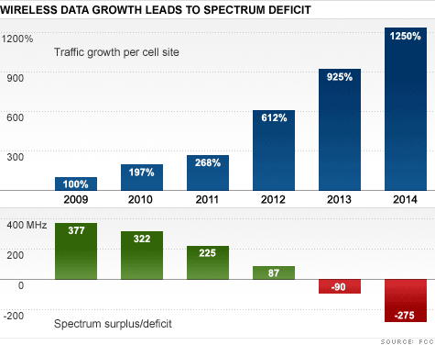
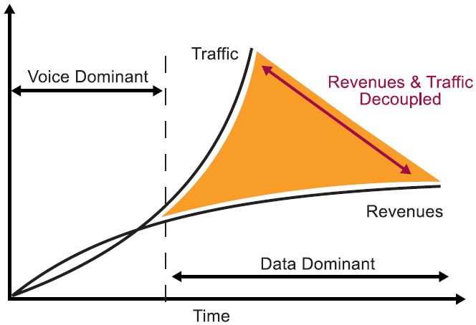
Careful what you wish for…
Exponential Mobile Data Growth
Leading to massive spectrum deficit
Source: FCC
Source: Unstrung Pyramid Research 2010
Growth in mobile data, massive spectrum deficit and stagnant revenues require technical and political breakthroughs for ongoing success of cellular
Notes:
Now Data “caps” are being instituted to deal with the economics of mobile data use.

Slide 16
Rethinking “Cells” in Cellular
How should cellular
systems be designed?
Coop
MIMO
Femto
Relay
Will gains in practice be
big or incremental; in
capacity or coverage?
DAS
Traditional cellular design “interference-limited”
  MIMO/multiuser detection can remove interference
  Cooperating BSs form a MIMO array: what is a cell?
  Relays change cell shape and boundaries
  Distributed antennas move BS towards cell boundary
  Femtocells create a cell within a cell
  Mobile cooperation via relays, virtual MIMO, network coding.

Slide 17







The Future Cellular Network: Hierarchical Architecture
Today’s architecture
3M Macrocells serving 5 billion users
Anticipated 1M small cells per year
10x Lower COST/Mbps
MACRO: solving initial coverage issue, existing network
PICO: solving street, enterprise & home coverage/capacity issue
(more with WiFi Offload)
10x CAPACITY Improvement
Near 100%
COVERAGE
Macrocell
Picocell
Femtocell
Future systems require Self-Organization (SON) and WiFi Offload
Notes:
“Smart Phones” already can automatically switch to WiFi for data when available (under user control) and the user can choose to use VIOP for voice.
The “Internet Backbone” still carries the traffic in most cases.

Slide 18



SON Premise and Architecture
Mobile Gateway
Or Cloud
Node Installation
Self
Healing
SoN
Server
Initial Measurements
SON
Server
IP Network
Self Configuration
Measurement
Self Optimization
X2
X2
SW
Agent
X2
X2
SON is part of 3GPP/LTE standard
Small cell BS
Macrocell BS
Notes:
Self-Organizing-Network: Assumes the “smarts” are in the network vs putting the “smarts” in the user device. My prediction is that the use of Smart phones will make any SON obsolete.

Slide 19
Green” Cellular Networks
Pico/Femto
How should cellular
systems be redesigned
for minimum energy?
Coop
MIMO
Relay
Research indicates that
significant savings is possible
DAS
Minimize energy at both the mobile and base station via
  New Infrastuctures: cell size, BS placement, DAS, Picos, relays
  New Protocols: Cell Zooming, Coop MIMO, RRM, Scheduling, Sleeping, Relaying
  Low-Power (Green) Radios: Radio Architectures, Modulation, coding, MIMO

Slide 20
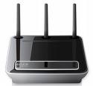
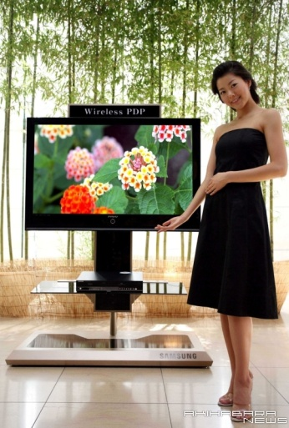

Wifi Networks
Multimedia Everywhere, Without Wires
802.11n++
Streaming video
Gbps data rates
High reliability
Coverage in every room
Wireless HDTV
and Gaming
Notes:
My home is wired for 100 Mb/sec. No longer used except for Uverse (AT&T TV/data/Phone service)

Slide 21
Wireless Local Area Networks (WLANs)
01011011
0101
1011
Internet
Access
Point
WLANs connect “local” computers (100m range)
Breaks data into packets
Channel access is shared (random access)
Backbone Internet provides best-effort service
  Poor performance in some apps (e.g. video)

Slide 22
Wireless LAN Standards
802.11b (Old – 1990s)
  Standard for 2.4GHz ISM band (80 MHz)
  Direct sequence spread spectrum (DSSS)
  Speeds of 11 Mbps, approx. 500 ft range
802.11a/g (Middle Age– mid-late 1990s)
  Standard for 5GHz band (300 MHz)/also 2.4GHz
  OFDM in 20 MHz with adaptive rate/codes
  Speeds of 54 Mbps, approx. 100-200 ft range
802.11n
  Standard in 2.4 GHz and 5 GHz band
  Adaptive OFDM /MIMO in 20/40 MHz (2-4 antennas)
  Speeds up to 600Mbps, approx. 200 ft range
  Other advances in packetization, antenna use, etc.
Many
WLAN
cards
have
all 3
(a/b/g)
What’s next?
802.11ac/ad

Slide 23


Convergence of Cellular and WiFi
LTE.11
Seamless handoff between networks
Load-balancing of air interface and backbone
Carrier-grade performance on both networks
Notes:
Again, this is already partially supported by Smart Phones (iPhone, Android, Win8).
“Carrier Grade” has been redefined down in the digital age.

Slide 24
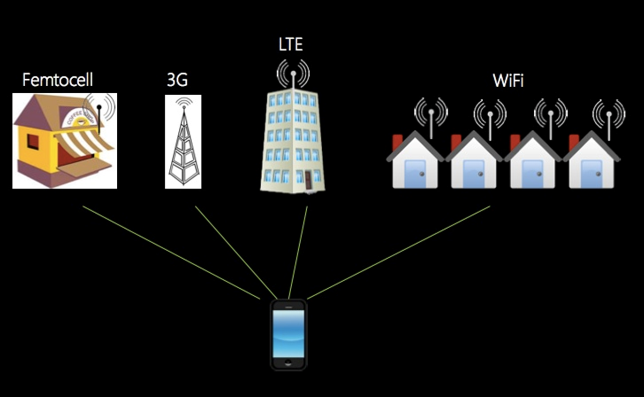
Software-Defined Network Virtualization
Wireless Network Virtualization Layer
Network virtualization combines hardware and software network resources and functionality into a single, software-based virtual network

Slide 25
WiGig and Wireless HD
New standards operating in 60 GHz band
Data rates of 7-25 Gbps
Bandwidth of around 10 GHz (unregulated)
Range of around 10m (can be extended)
Uses/extends 802.11 MAC Layer
Applications include PC peripherals and displays for HDTVs, monitors & projectors

Slide 26
Satellite Systems
Cover very large areas
Different orbit heights
  GEOs (39000 Km) versus LEOs (2000 Km)
Optimized for one-way transmission
  Radio (XM, Sirius) and movie (SatTV, DVB/S) broadcasts
  Most two-way systems struggling or bankrupt
Global Positioning System (GPS) use growing
  Satellite signals used to pinpoint location
  Popular in cell phones, PDAs, and navigation devices
Notes:
GEO – high latency!
LEO – High complexity!

Slide 27
IEEE 802.15.4/ZigBee Radios
Low-Rate WPAN
Data rates of 20, 40, 250 Kbps
Support for large mesh networking or star clusters
Support for low latency devices
CSMA-CA channel access
Very low power consumption
Frequency of operation in ISM bands
Focus is primarily on low power sensor networks

Slide 28
Tradeoffs
3G
802.11n
Rate
802.11g/a
Power
802.11b
UWB
Bluetooth
ZigBee
Range

Slide 29
Scarce Wireless Spectrum
$$$
and Expensive

Slide 30
Spectrum Regulation
Spectrum a scarce public resource, hence allocated
Spectral allocation in US controlled by FCC (commercial) or OSM (defense)
FCC auctions spectral blocks for set applications.
Some spectrum set aside for universal use
Worldwide spectrum controlled by ITU-R
Regulation is a necessary evil.
Innovations in regulation being considered worldwide
in multiple cognitive radio paradigms

Slide 31

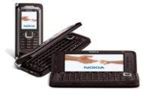
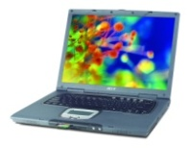
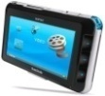
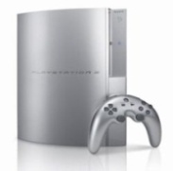

Spectral Reuse
Due to its scarcity, spectrum is reused
In licensed bands
and unlicensed bands
BS
Cellular, Wimax
Wifi, BT, UWB,…
Reuse introduces interference

Slide 32
Cognitive Radios
Cognitive radios can support new wireless users in existing crowded spectrum
  Without degrading performance of existing users
Utilize advanced communication and signal processing techniques
  Coupled with novel spectrum allocation policies
Technology could
  Revolutionize the way spectrum is allocated worldwide
  Provide sufficient bandwidth to support higher quality and higher data rate products and services

Slide 33
Cognitive Radio Paradigms
Underlay
  Cognitive radios constrained to cause minimal interference to noncognitive radios
Interweave
  Cognitive radios find and exploit spectral holes to avoid interfering with noncognitive radios
Overlay
  Cognitive radios overhear and enhance noncognitive radio transmissions
Knowledge
and
Complexity

Slide 34
Standards
Interacting systems require standardization
Companies want their systems adopted as standard
  Alternatively try for de-facto standards
Standards determined by TIA/CTIA in US
  IEEE standards often adopted
  Process fraught with inefficiencies and conflicts
Worldwide standards determined by ITU-T
  In Europe, ETSI is equivalent of IEEE
Standards for current systems are summarized in Appendix D.

Slide 35
Emerging Systems*
Cognitive radio networks
Ad hoc/mesh wireless networks
Sensor networks
Distributed control networks
The smart grid
Biomedical networks
*Can have a bonus lecture on this topic late in the semester if there is interest

Slide 36
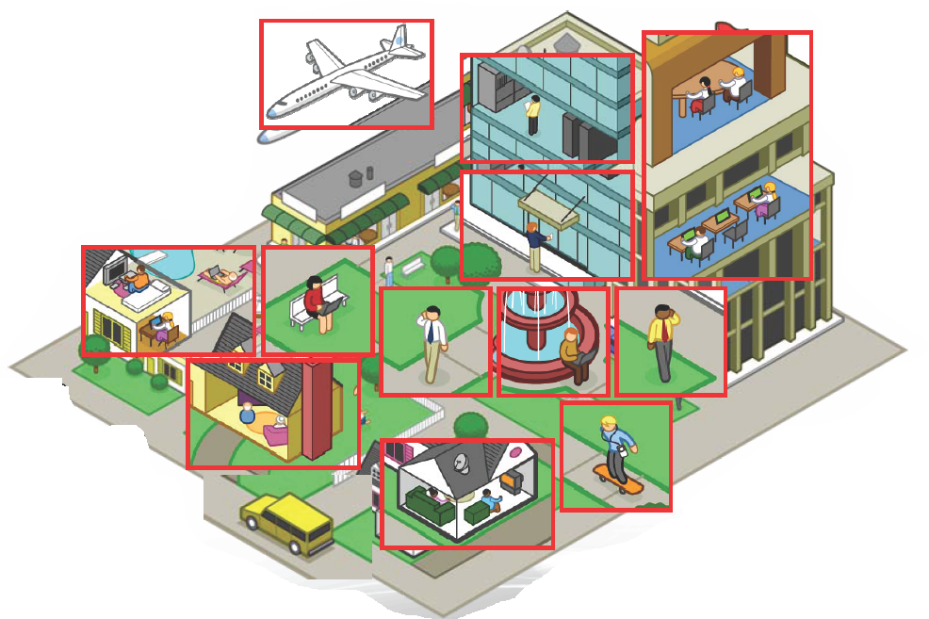
Ad-Hoc/Mesh Networks
ce
Outdoor Mesh
Indoor Mesh

Slide 37
Design Issues
Ad-hoc networks provide a flexible network infrastructure for many emerging applications.
The capacity of such networks is generally unknown.
Transmission, access, and routing strategies for ad-hoc networks are generally ad-hoc.
Crosslayer design critical and very challenging.
Energy constraints impose interesting design tradeoffs for communication and networking.

Slide 38
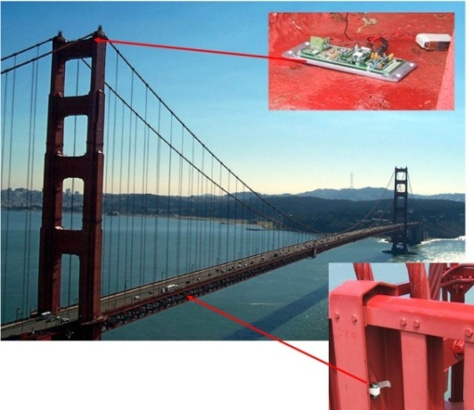
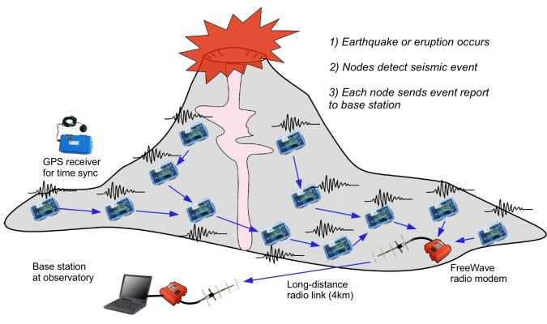
Wireless Sensor Networks
Data Collection and Distributed Control
Smart homes/buildings
Smart structures
Search and rescue
Homeland security
Event detection
Battlefield surveillance
Energy (transmit and processing) is the driving constraint
Data flows to centralized location (joint compression)
Low per-node rates but tens to thousands of nodes
Intelligence is in the network rather than in the devices

Slide 39
Energy-Constrained Nodes
Each node can only send a finite number of bits.
  Transmit energy minimized by maximizing bit time
  Circuit energy consumption increases with bit time
  Introduces a delay versus energy tradeoff for each bit
Short-range networks must consider transmit, circuit, and processing energy.
  Sophisticated techniques not necessarily energy-efficient.
  Sleep modes save energy but complicate networking.
Changes everything about the network design:
  Bit allocation must be optimized across all protocols.
  Delay vs. throughput vs. node/network lifetime tradeoffs.
  Optimization of node cooperation.
Notes:
All the sophisticated high-performance communication techniques developed since WW2 may need to be thrown out the window.
By cooperating, nodes can save energy

Slide 40

Distributed Control over Wireless
Automated Vehicles
- Cars
- Airplanes/UAVs
- Insect flyers
  Interdisciplinary design approach
    Control requires fast, accurate, and reliable feedback.
    Wireless networks introduce delay and loss
    Need reliable networks and robust controllers
    Mostly open problems
: Many design challenges

Slide 41
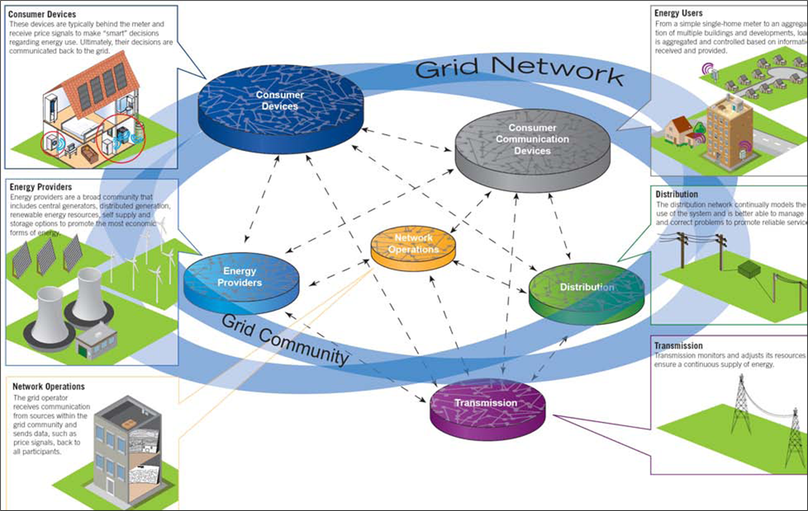
The Smart Grid:
Fusion of Sensing, Control, Communications
carbonmetrics.eu

Slide 42


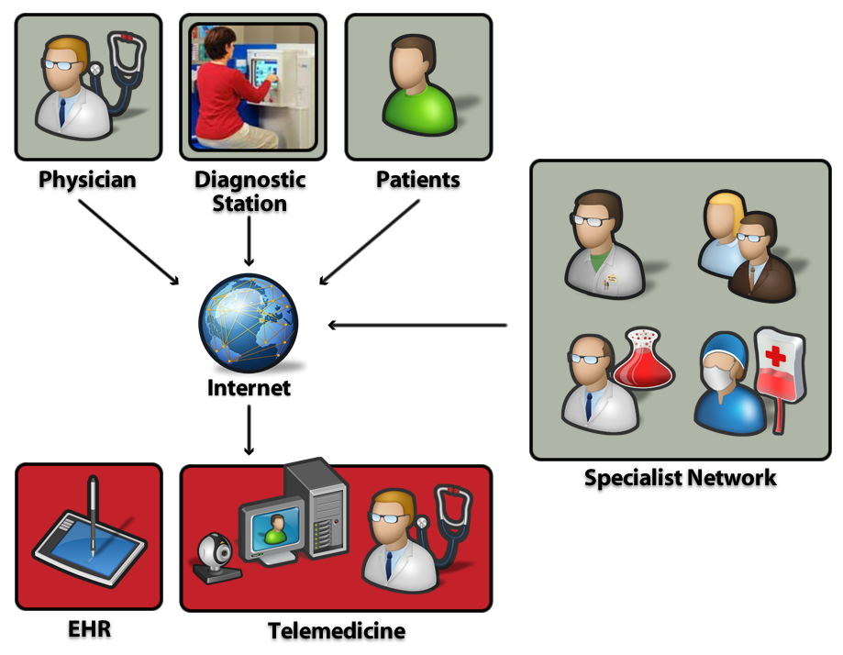
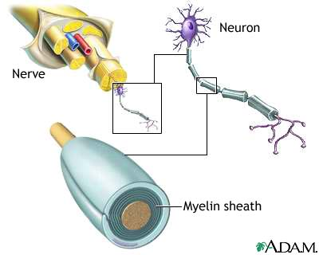
Applications in Health,
Biomedicine and Neuroscience
Neuro/Bioscience
EKG signal reception/modeling
Brain information theory
Nerve network (re)configuration
Implants to monitor/generate signals
In-brain sensor networks
Body-Area
Networks
Doctor-on-a-chip
Recovery from
Nerve Damage
Wireless
Network

Slide 43
Main Points
The wireless vision encompasses many exciting systems and applications
Technical challenges transcend across all layers of the system design.
Cross-layer design emerging as a key theme in wireless.
Existing and emerging systems provide excellent quality for certain applications but poor interoperability.
Standards and spectral allocation heavily impact the evolution of wireless technology

