Slide 1
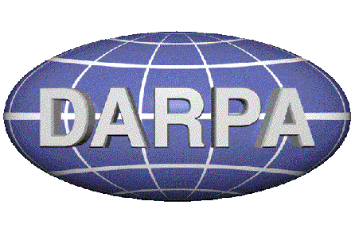



Introduction to Nanoelectronics
EE 315 / ECE 451
Ryan Munden
Fairfield University
BNW 105, x2764
rmunden@fairfield.edu

Slide 2
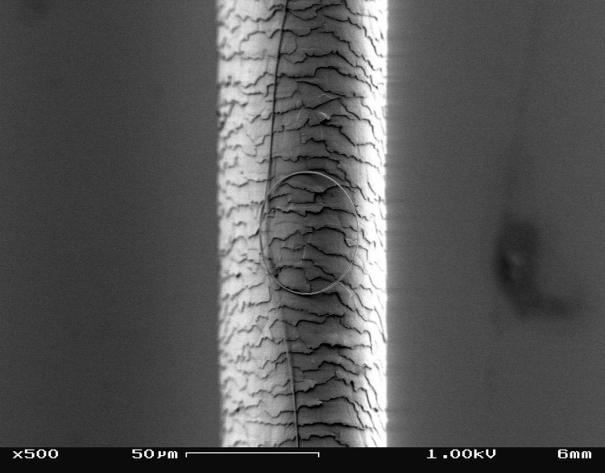
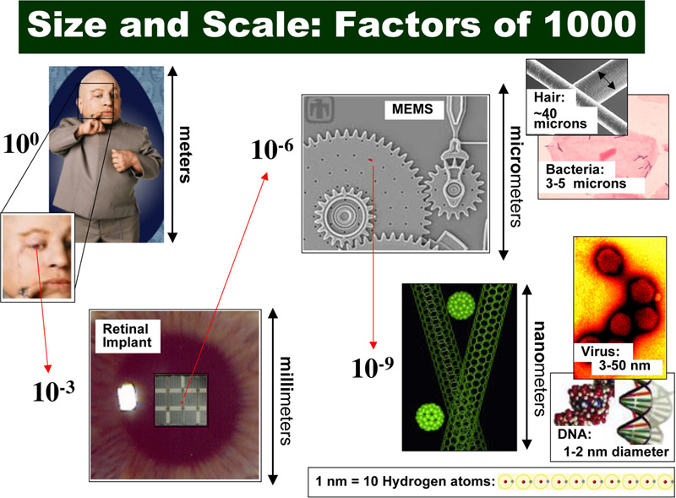
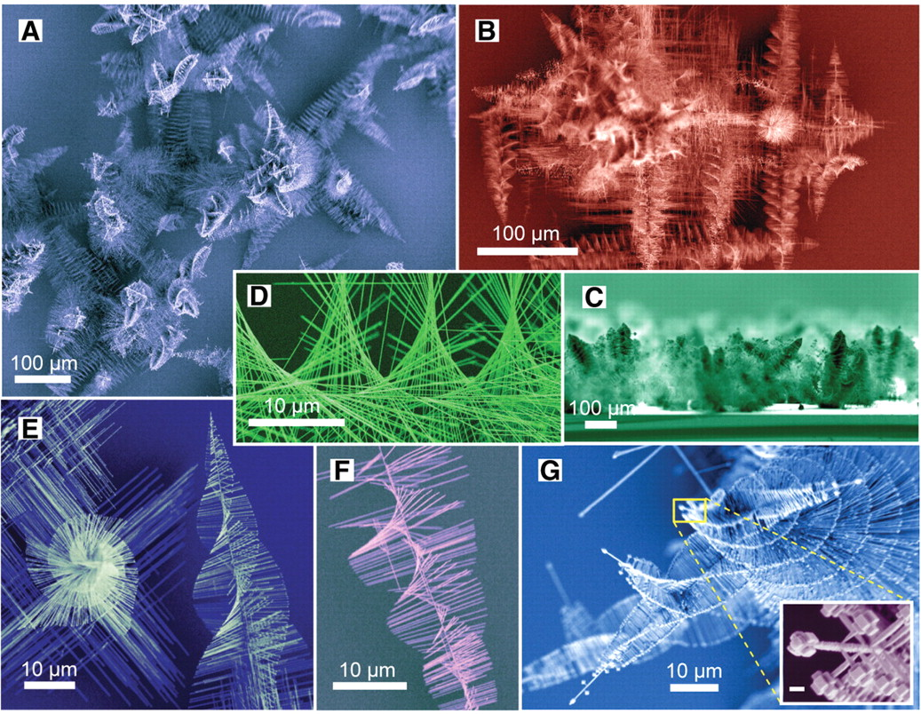
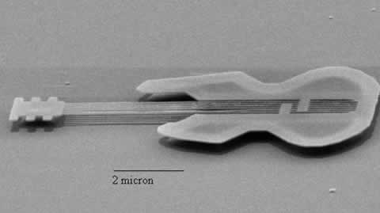
How Small is Nano?

Slide 3
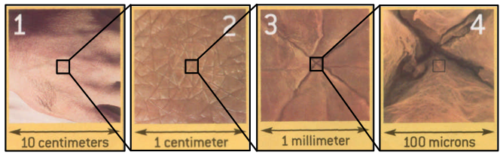
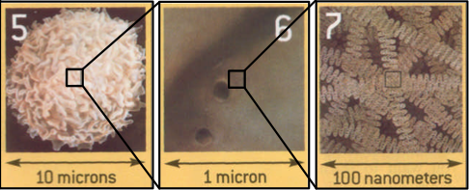
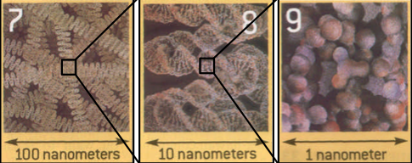
How Big is a Nanometer under the Microscope?
3
Consider a human hand
skin
white blood cell
DNA
nanoscale
atoms
Source: http://www.materialsworld.net/nclt/docs/Introduction%20to%20Nano%201-18-05.pdf
Notes:
Goal: Understanding of the nanoscale with multiple examples

Slide 4
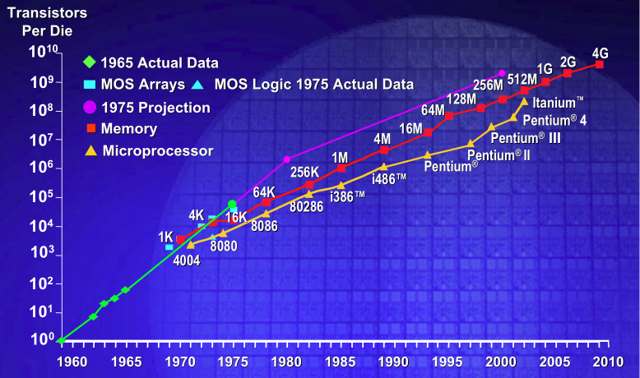
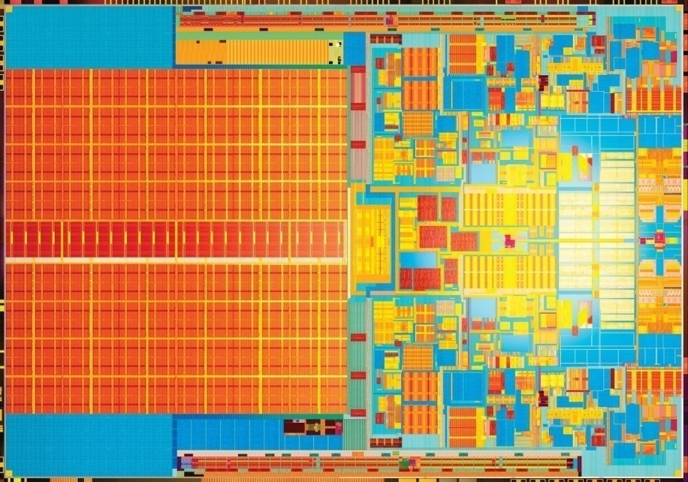
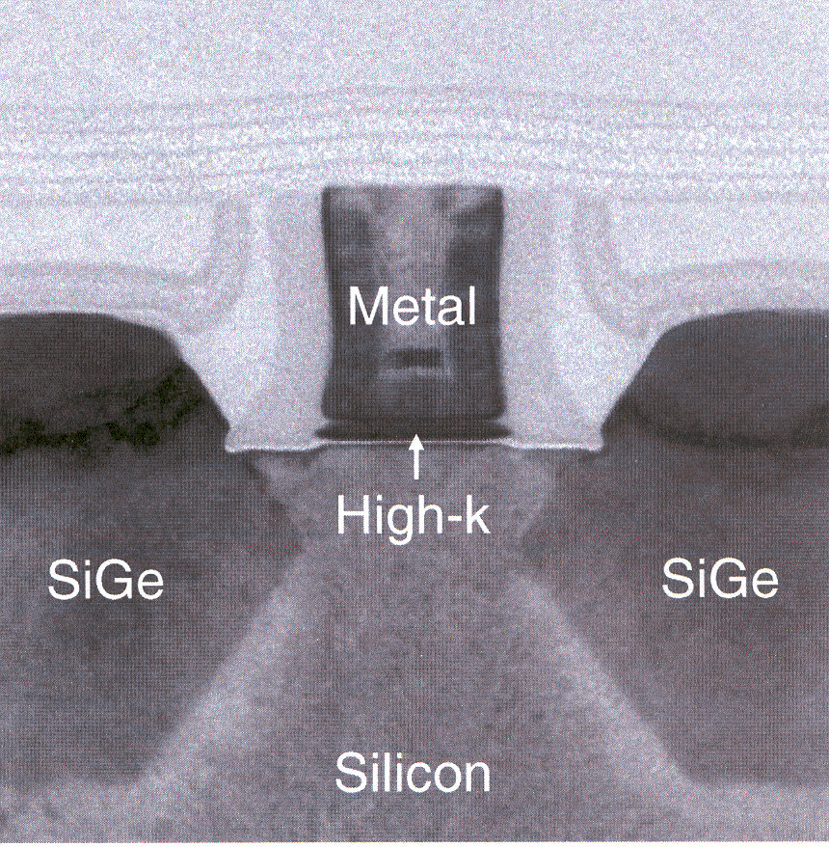
Moore’s Law – Scaling beyond 22 nm node
An empirical law from the 70’s that the number of transistors on a die will double every 18 months. This has been driving the technology industry for decades along the ITRS roadmap.
Intel dual-core 45nm high-k metal gate - today

Slide 5
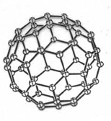
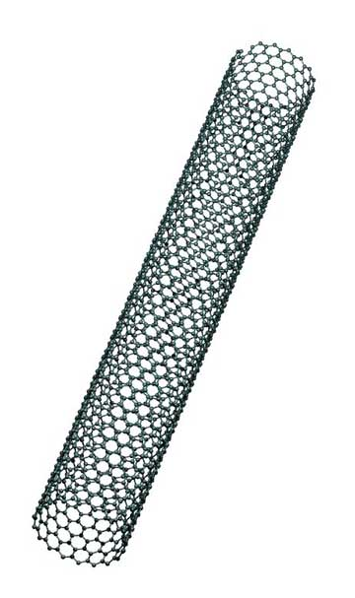
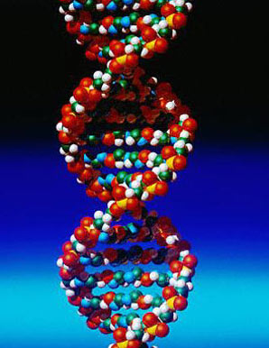
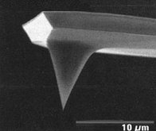
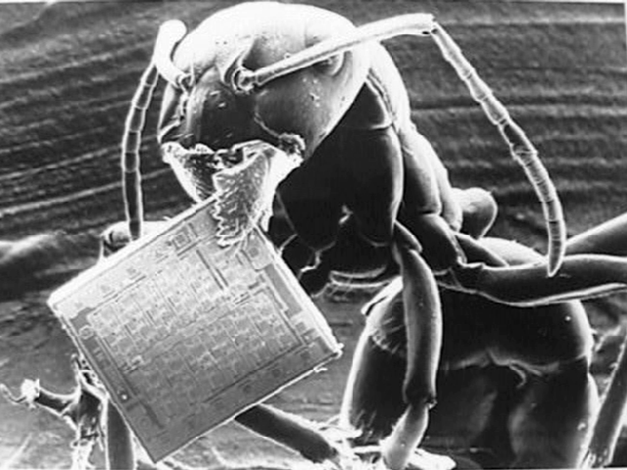
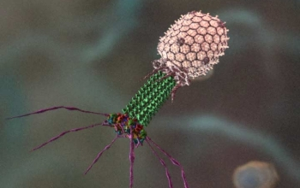
Nanotechnology – the answer to Moore’s law?
Intersection of Physics and Engineering with Chemistry and Biology

Slide 6




Examples of current commercial products
Cosmetics (skin care products)
Tennis balls which last longer
Wrinkle free fabrics, “nano-fabrics”
Sunscreen with transparent zinc-oxide
Notes:
An example of a commercial product: a fabric that does not get wet.
A cotton fiber is a round cylinder. On a nano scale, it's the size of a tree trunk. Now imagine grafting lots of little hairs onto the tree trunk until it creates a peach fuzz effect. One can do this to the fibers, using nano-whiskers, which are built atom-by-atom. It is amazing that we can actually do this feat. The whiskers have to be the right shape. They have to be able to be suspended in water so that when fabric is dipped into a nano-whisker solution the whiskers will land on the surface and stick with the blades pointing up.
The fuzz on the fibers is permanent — it changes the fabric itself so it can't wash or wear off like other coatings used to make cotton resist wrinkles and stains. It is also undetectable, except when seen under a high-power microscope.
The fuzz creates a cushion of air around the fibers. When water hits the fabric, it beads up on the cushion and rolls off. It can't get through. But if force is applied to the water, it passes through the fabric but doesn't get absorbed by the fibers — so sweat, for instance, can still be whisked away from your body. Apply this to a pair of khakis, and you get pants that resist wrinkles, stay dry in the rain and wipe clean when, for instance, air turbulence shimmies your coffee cup off the airline tray table and onto your lap.”
(Kevin Maney, 2002, Nanotech advances in a new fabric, USA TODAY retrieved on August 10, 2007 from http://www.usatoday.com/tech/columnist/cckev060.htm)

Slide 7
Impact of Nanotechnology on Global Economy
Between 1997 and 2005, governments around the world invested from $432 million to about $4.1 billion in nanotech research and development, and by 2005 private funding exceeded government funding. By 2015 it is estimated that nanotech products will contribute approx. $1 trillion to the global economy, with about 2 million workers employed in nanotech industries and 3X that many in supporting jobs (Roco, 2006).
Notes:
Goal:
The importance of the global race in nanotechnology shaould be addressed. Note the number of countries who are heavily investing in advances in nanotech research
The federal government, through the guiding efforts of the U.S. National Nanotechnology Initiative (NNI), is supporting research in nanotechnology. As a result of the NNI research efforts, the United States is a global leader in nanotechnology development.
How much money is the U.S. government spending on nanotechnology?
Federal funding for nanotechnology R&D has increased substantially since inception of the NNI,
from $464 million in 2001 to an estimated $1,392 million in 2007. The 2008 budget request that
President Bush has sent to Congress calls for a total NNI budget of $1,445 million.
What products available today have resulted from nanoscience?
Numerous products featuring the unique properties of nanoscale materials are available to
consumers and industry today. Most computer hard drives, for instance, contain giant
magnetoresistance (GMR) heads that, through nano-thin layers of magnetic materials, allow for
a significant increase in storage capacity. Other electronic applications include non-volatile
magnetic memory, automotive sensors, landmine detectors and solid-state compasses.
Some other current uses that are already in the marketplace include:
Burn and wound dressings
Water filtration
Catalysis
A dental-bonding agent
Step assists on vans.
Coatings for easier cleaning glass
Bumpers and catalytic converters on cars
Protective and glare-reducing coatings for eyeglasses and cars
Sunscreens and cosmetics.
Longer-lasting tennis balls.
Light-weight, stronger tennis racquets.
Stain-free clothing and mattresses.
Ink. “
From http://www.nano.gov/html/facts/faqs.html

Slide 8
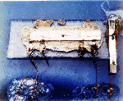
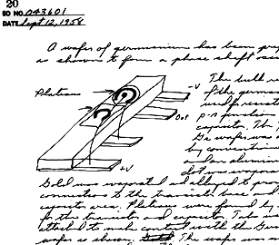
Applications, Integrated Circuits
Modern Electrical Computers:
First Integrated Circuit
Jack Kilby (TI) (12 Sept. 1958)
invented while the rest of the company on vacation
awarded the Nobel Prize in 2000
Notes:
8
Historical background
The microprocessor is an integrated circuit that processes all information in the computer. It keeps track of what keys are pressed and if the mouse has been moved. It counts numbers and runs programs, games and the operating system. Integrated circuits are also found in almost every modern electrical device such as cars, television sets, CD players, cellular phones, etc. But what is an integrated circuit and what is the history behind it?
The integrated circuit is a very advanced electric circuit made from different electrical components such as transistors, resistors, capacitors and diodes, that are connected to each other in different ways. These components have different behaviors
The transistor acts like a switch.
The resistor limits the flow of electricity
The capacitor collects electricity and releases it all in one quick burst;
The diode stops electricity under some conditions and or allows it to pass in one direction only when these conditions change
A good example is to ask how long it would take to assemble a modern IC (approx 1E9 transistors) if you placed 1 every second, 24 hrs, 7 days a week
(a year is ~ 3E7 seconds)
The main lesson here is the power of circuit integration & parallel processing
See Kilby’s Nobel lecture:
http://nobelprize.org/nobel_prizes/physics/laureates/2000/kilby-lecture.html

Slide 9
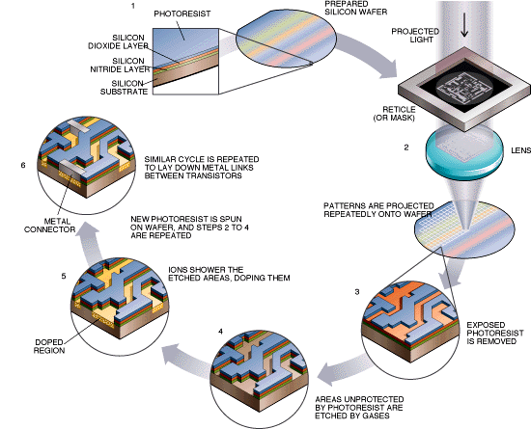
Integrated Circuits on a Silicon Chip: Parallel microchip fabrication
Notes:
9
Illustration of the main steps of microfabrication. Start at the top.
Starts with a silicon wafer. Spin on photoresist (PR) - PR is essentially liquid film. Use a mask (the master) to expose a pattern; develop (exither positive or negative tone). Use patterned PR to transfer pattern, for etching/deposition/etc. Repeat many times
The National Nanotechnology Infrastructure Network (http://www.nnin.org/) is a great resource, including outreach and tutorial resources

Slide 10
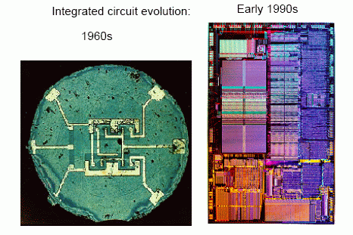
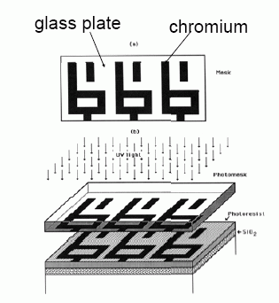
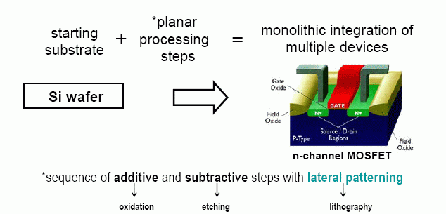
The critical innovation in IC nanofabrication: (photo)lithography
Notes:
10
The 1960 IC is the first by Fairchild.
The basic building block is the Metal-Oxide-Semiconductor Field Effect Transistor (MOS-FET)

Slide 11
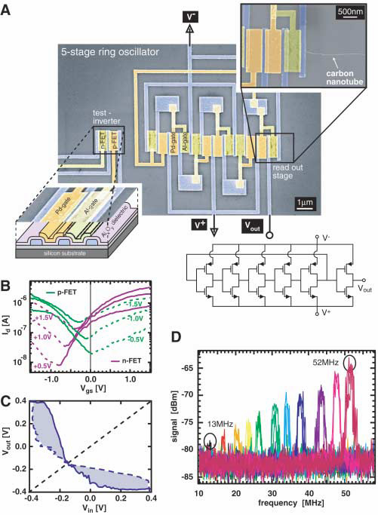
Carbon Nanotube IC – A Ring Oscillator
Z.H. Chen, J. Appenzeller, Y.M. Lin, J. Sippel-Oakley, A.G. Rinzler, J.Y. Tang, S.J. Wind, P.M. Solomon, and P. Avouris, An integrated logic circuit assembled on a single carbon nanotube. Science, 311, 1735 (2006).

Slide 12
Solar Energy Conversion
Pursue high-efficiency photovoltaics by enhancing the solar cell with nanowires
Work is currently in progress to enable growth of nanowire solar cell devices

Slide 13
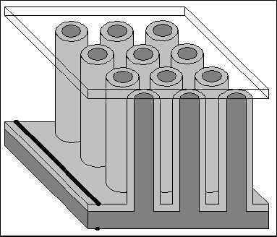
Radial P-N Junction Solar Cells
Collection – the nanowire surface is a better photon collector (it’s “blacker”)
Enhanced charge extraction due to shorter distance to junction interface (the junction is everywhere)
Brendan Kayes, et. al. JOURNAL OF APPLIED PHYSICS 97, 114302 (2005)
Arrays of radial pn junction nanowires are theorized to be the most efficient form for creating solar cells.

Slide 14
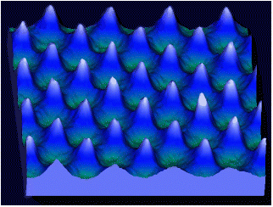
Nanofabrication
Devices are designed and manufactured at nanometer scale by top-down techniques, such as lithography, or laser deposition
Fig 5- Atomic force microscope of a 2D array of Chromium dots. These are formed using laser atomic deposition.
Dustin Carr and Harold Craighead of Cornell University’s Nanofabrication Facility. The nano-guitar is 10 micrometers long, about the size of a single cell human blood cell. Each of the six strings are 50 nanometers wide, about the width of 10 atoms.
Notes:
Resource: Journal of Nanoscience and Nanotechnology
Nanostructure can be built from top-down (thin films) or bottom-up processes. Among the bottom-up strategies, self-assembly provides a promising route to build up complex systems in terms of nanoscale building blocks and with useful resulting functionalities and properties. Self-assembly is a process in which organization of colloidal, macromolecular, or supramolecular units into the desired system occurs through nature-intended phenomena, either mediated by physicochemical pathways or assisted by biomolecules to promote molecular selectivity and specificity. Current research is focused mainly on the combination of molecular/biomacromolecular self-assembly and nanostructured materials for electronic, photonic and biological applications. See http://depts.washington.edu/jengroup/sam.htm

Slide 15
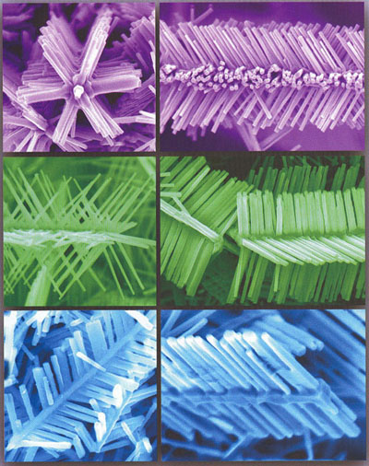
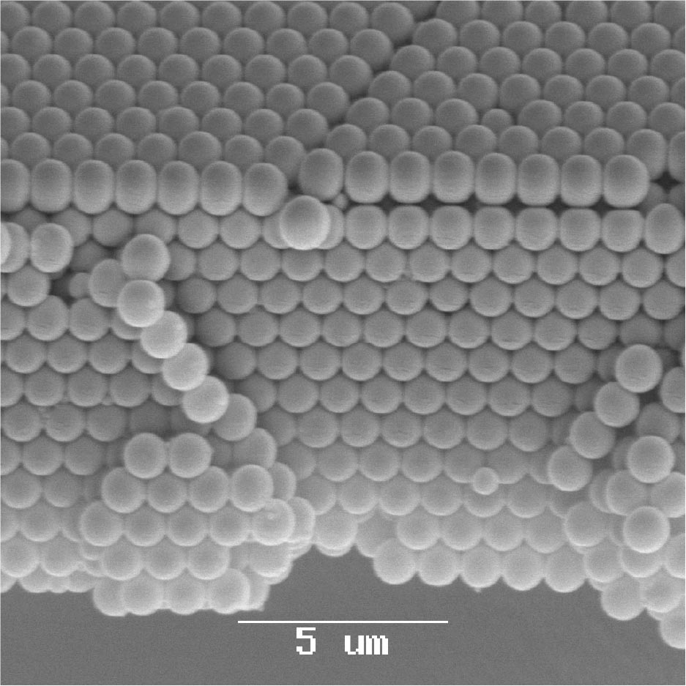
Nanofabrication
They are also fabricated, bottom-up, by growing in place, using molecular and atomic forces to direct the growth
Thorsten Schweizer, et al.Opaline-structured materials fabricated and further processed by ultrafast lasers make good templates for photonic crystal-based components.
7 April, 2008, SPIE Newsroom. DOI: 10.1117/2.1200803.1047
ZnO nanostructures - Z. Ren, J. Lao, and J. Wen. Nano Lett. 2002; 2(11).
Notes:
Self-assembly offers a very economical alternative to traditional approaches. Each new generation of Intel processsor requires a new $10 billion foundry to make them. Self-assembly can be done in a test-tube or in a table-top system.

Slide 16
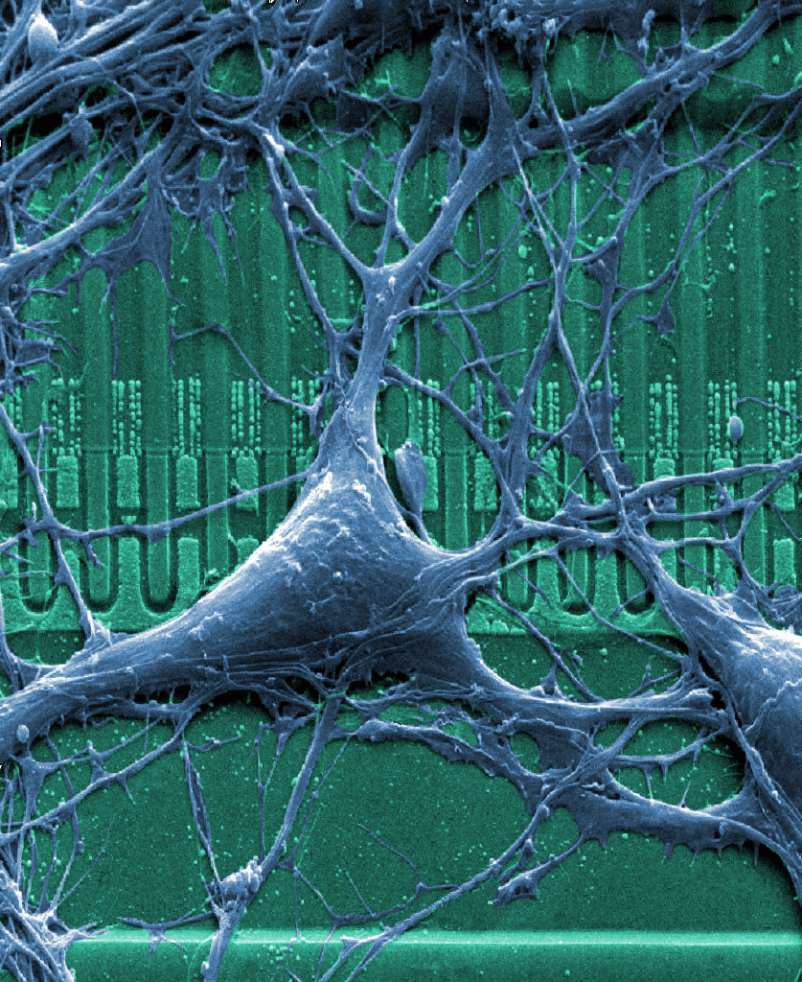
Electronics
Nanoelectronics combine biology, chemistry, physics, engineering, and computer science to create new computer chips (nanochips), nanomotors, nanoelectronics which hold the potential for faster, smaller, lower-power systems that could even interface with the body’s nervous system.
Notes:
Due to their small size and unique properties, carbon nanotubes have found a promising field of applications in electronics spanning vias, active devices, logic gates and even memory cells. In vertical interconnects (vias) carbon nanotubes are utilized as nanoscale wires in integrated circuits, while active devices refer to nanotube-based diodes and transistors. Logic gates and memories represent the most promising class of such applications, and are extremely likely to further benefit from the advances featured by the first two categories.
http://en.wikipedia.org/wiki/Nanoelectronics
Students may be assigned to learn the function of semiconductor diodes and transistors and the importance of nano-interconnects in high-density transistor circuits.

Slide 17
Thank You!

Slide 18
Why do we care about nanowires?
Bottom up electronic device fabrication
Integration of heterostructure (i.e. III-V) devices into CMOS processes
Sensing applications, high Surface-to-Volume ratio
Photonics, active optical elements, plasmon waveguides, efficient solar cells
May exhibit quasi-1D transport for interesting physics, memory, nanoelectronics

Slide 19
VLS Nanowire Synthesis
Vapor
Vapor phase consituents
Saturate Liquid catalyst drops
Precipitate crystalline solid onto substrate
Diameter controlled by catalyst drop size
Liquid
Solid

Slide 20
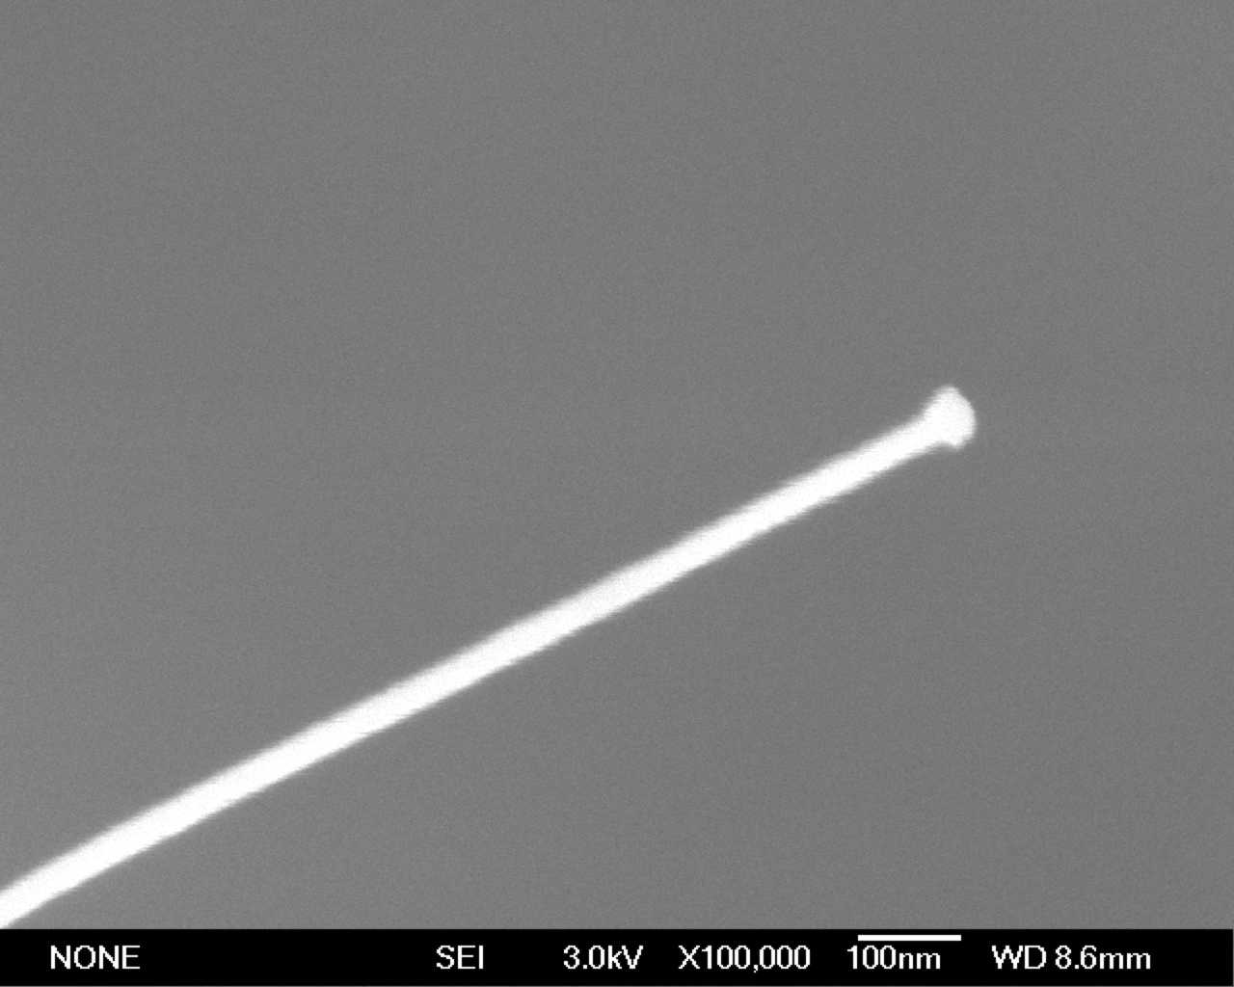
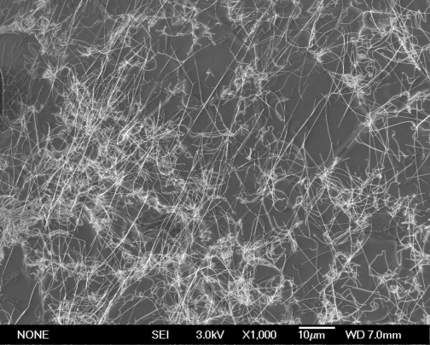
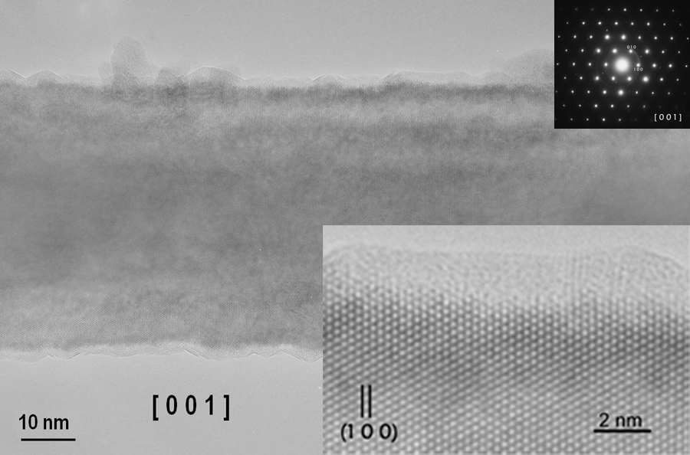
VLS Nanowires
Nanoparticle
catalyst
TEM
SEM
Cheng, et. al. APL 83, 1578 (2003).

Slide 21
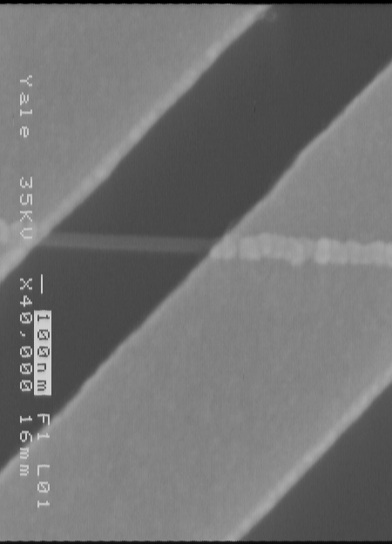
Nanowire FET – Electrical Characterization
V_{D}
Drain
Source
Gate
SiO₂
μ~ 10cm²/Vs
n ~10²⁰/cm³
Si
V_{G}

Slide 22
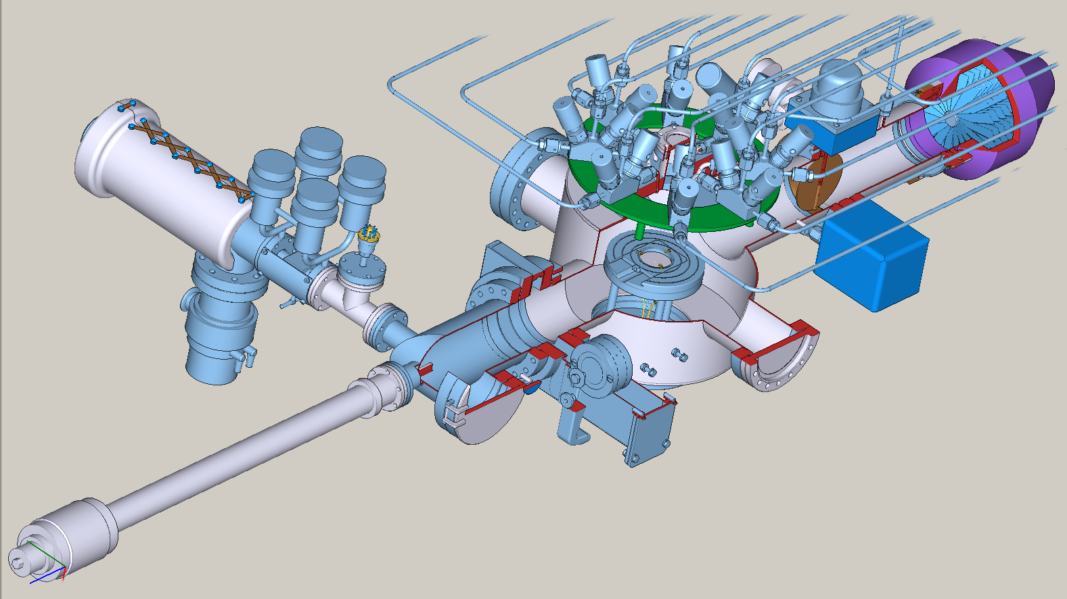
CBE Reactor Design

Slide 23
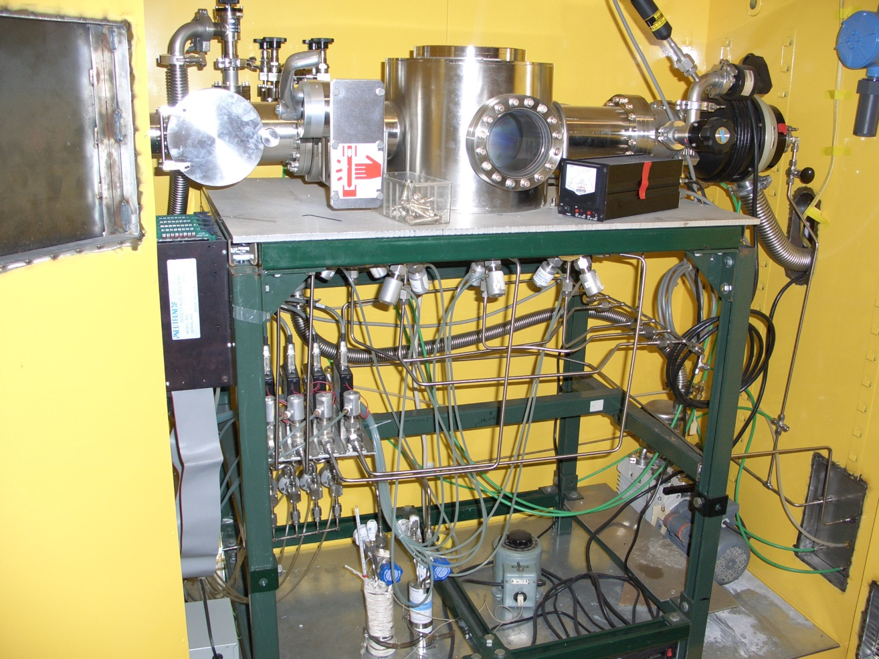
CBE Reactor
Chamber

Slide 24
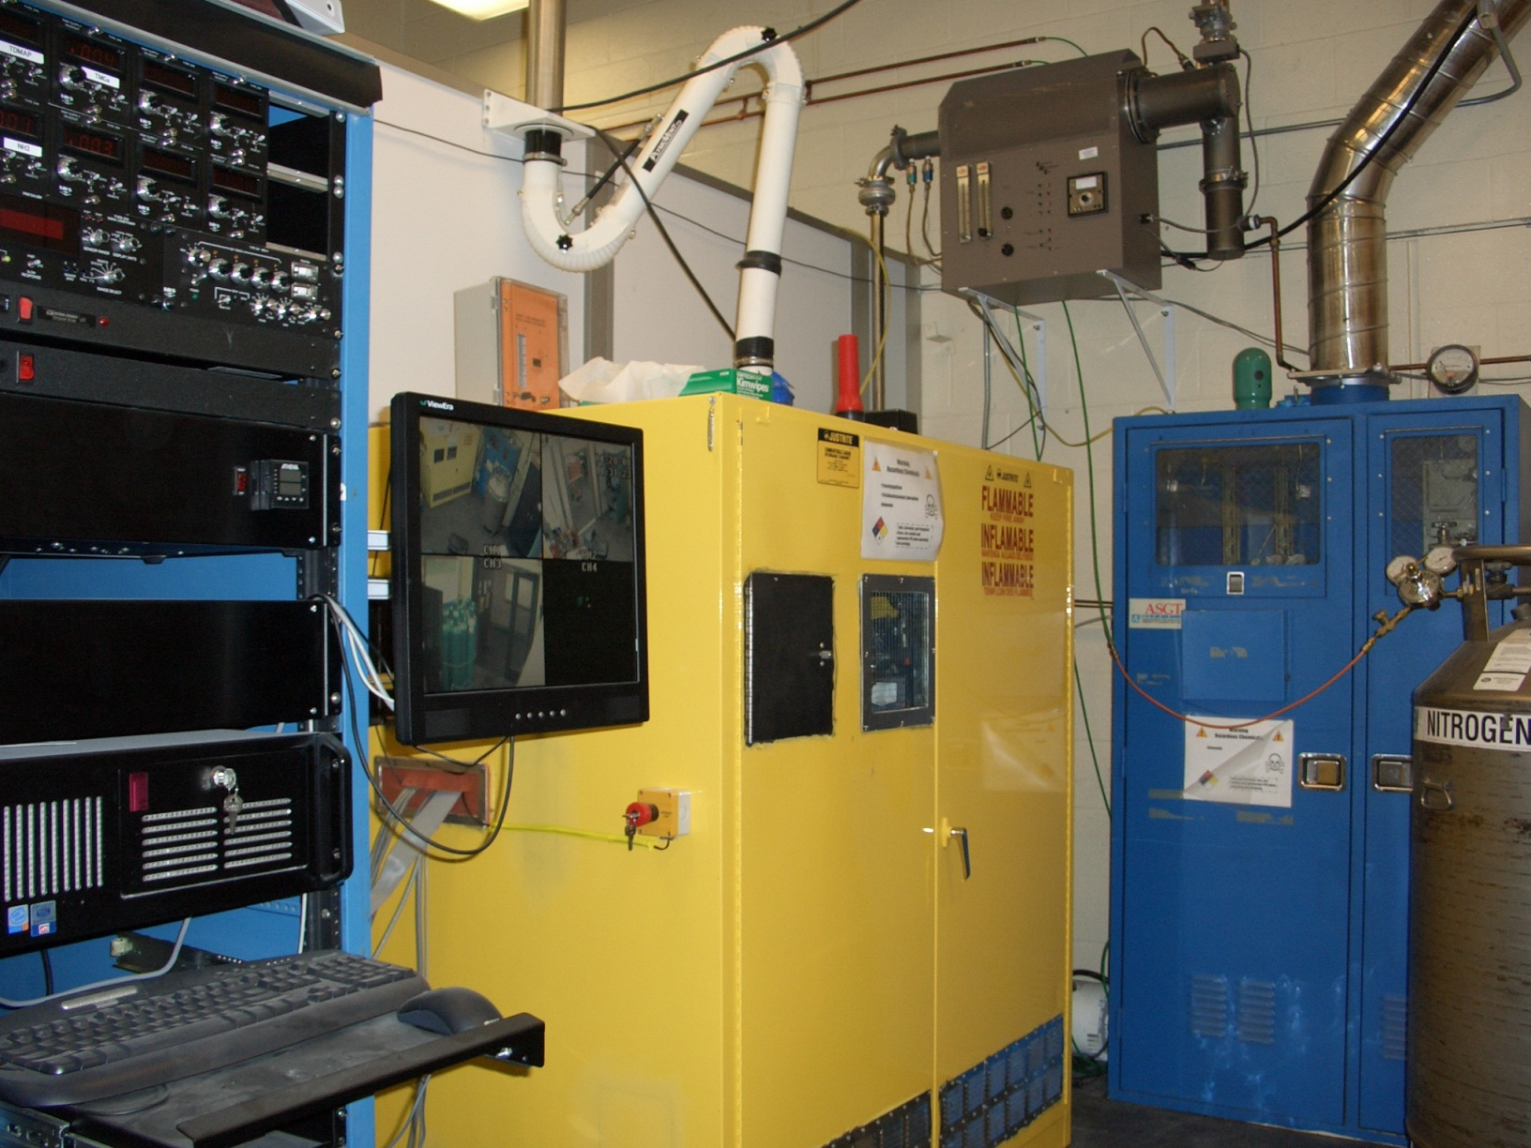
CBE Reactor
Construction

Slide 25
Crystal Aligned GaN Nanowires

